Slide 1
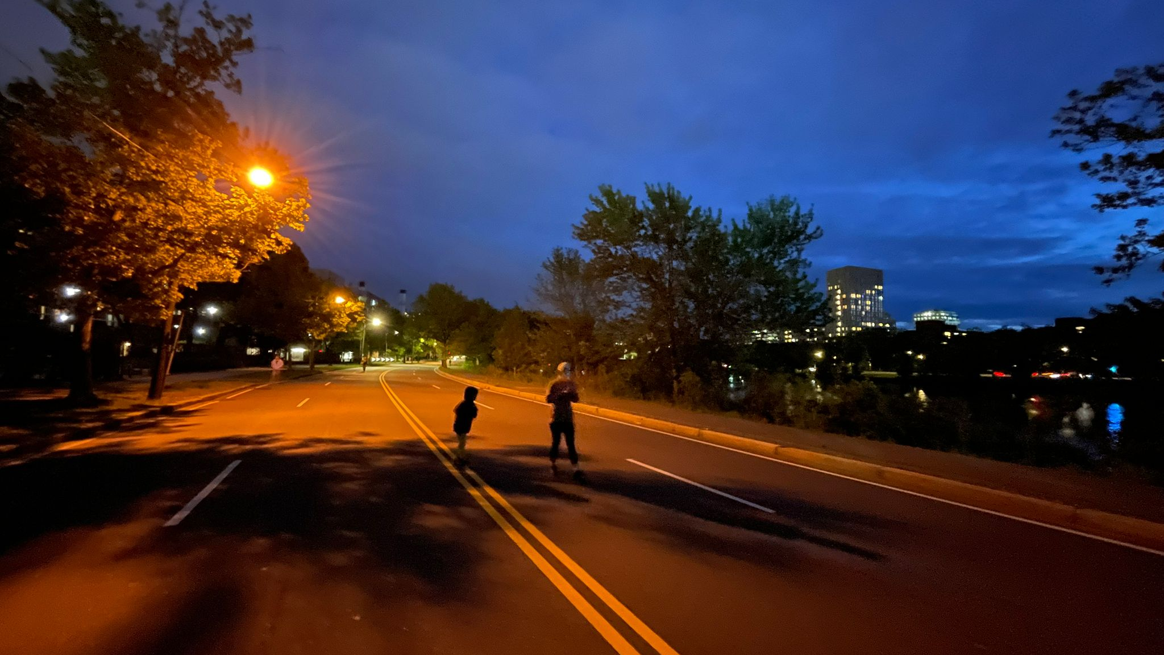
Owens Lab Meeting July 8th , 2025
Qian Tang

Slide 2
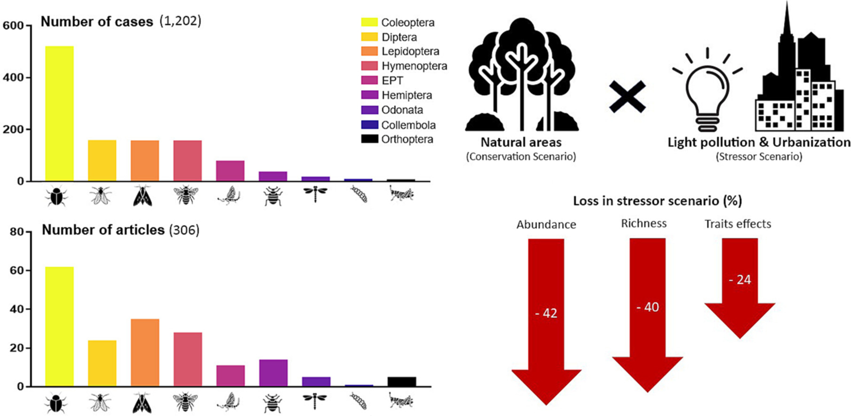
Vaz et al., 2023

Slide 3
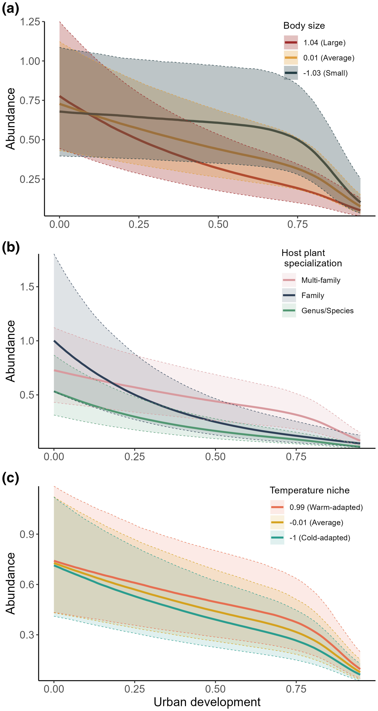
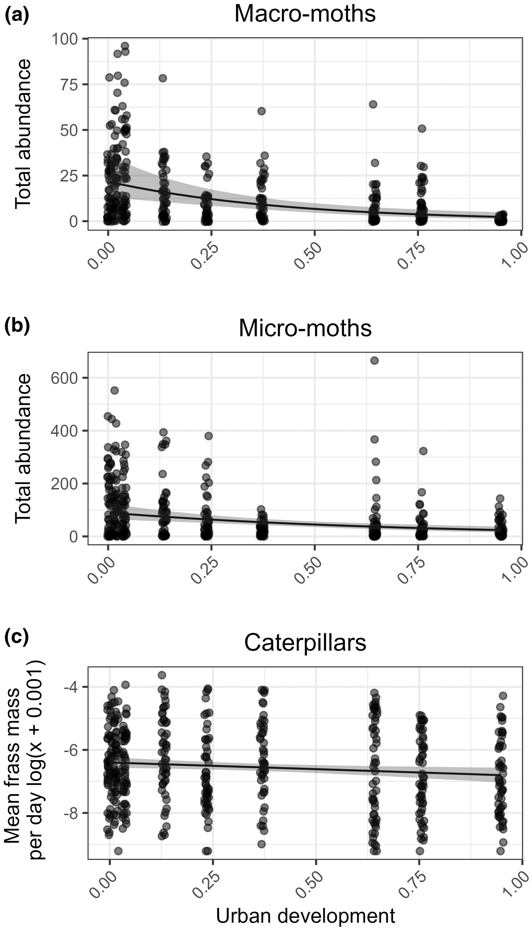
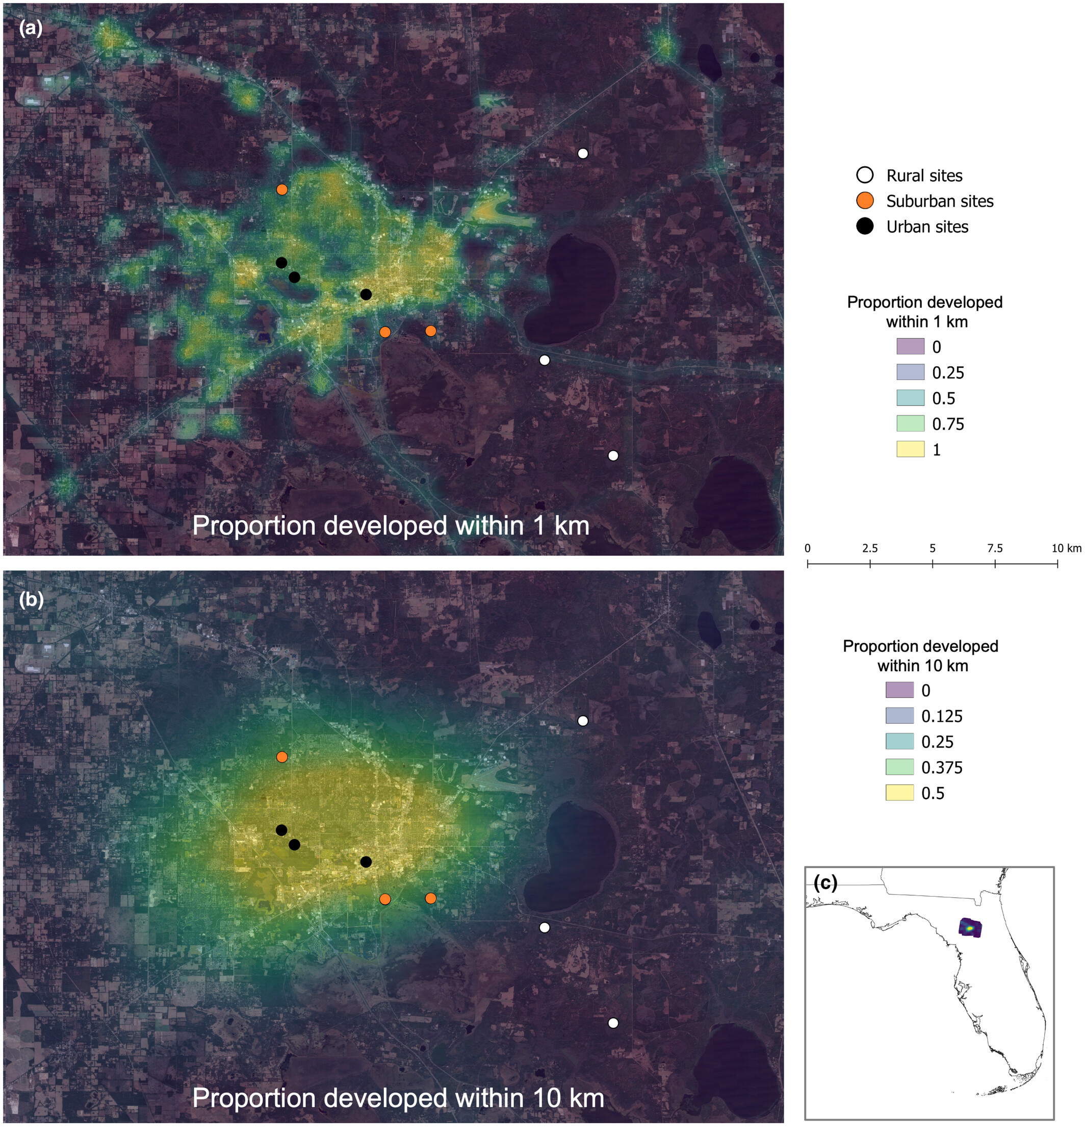
Belitz et al., 2024
Abundance and diversity
decline along urban gradient

Slide 4
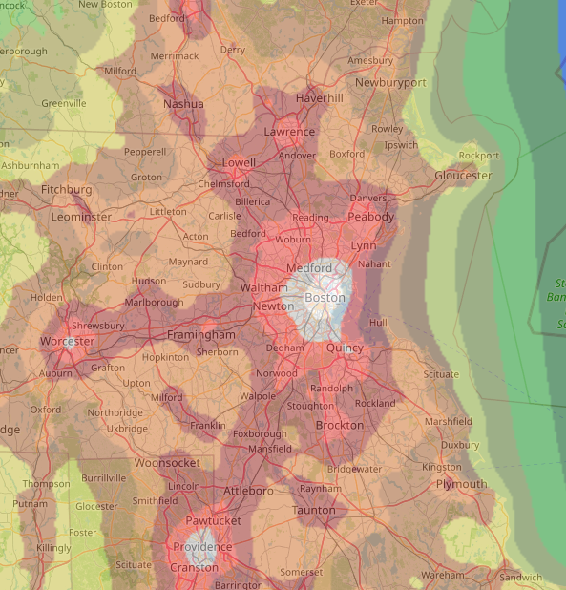
Activity?
Seasonality?
Phenological survey of
nocturnal insects along
urban gradient of the
Greater Boston
9 sites along 3 routes
3 traps per sites

Slide 5
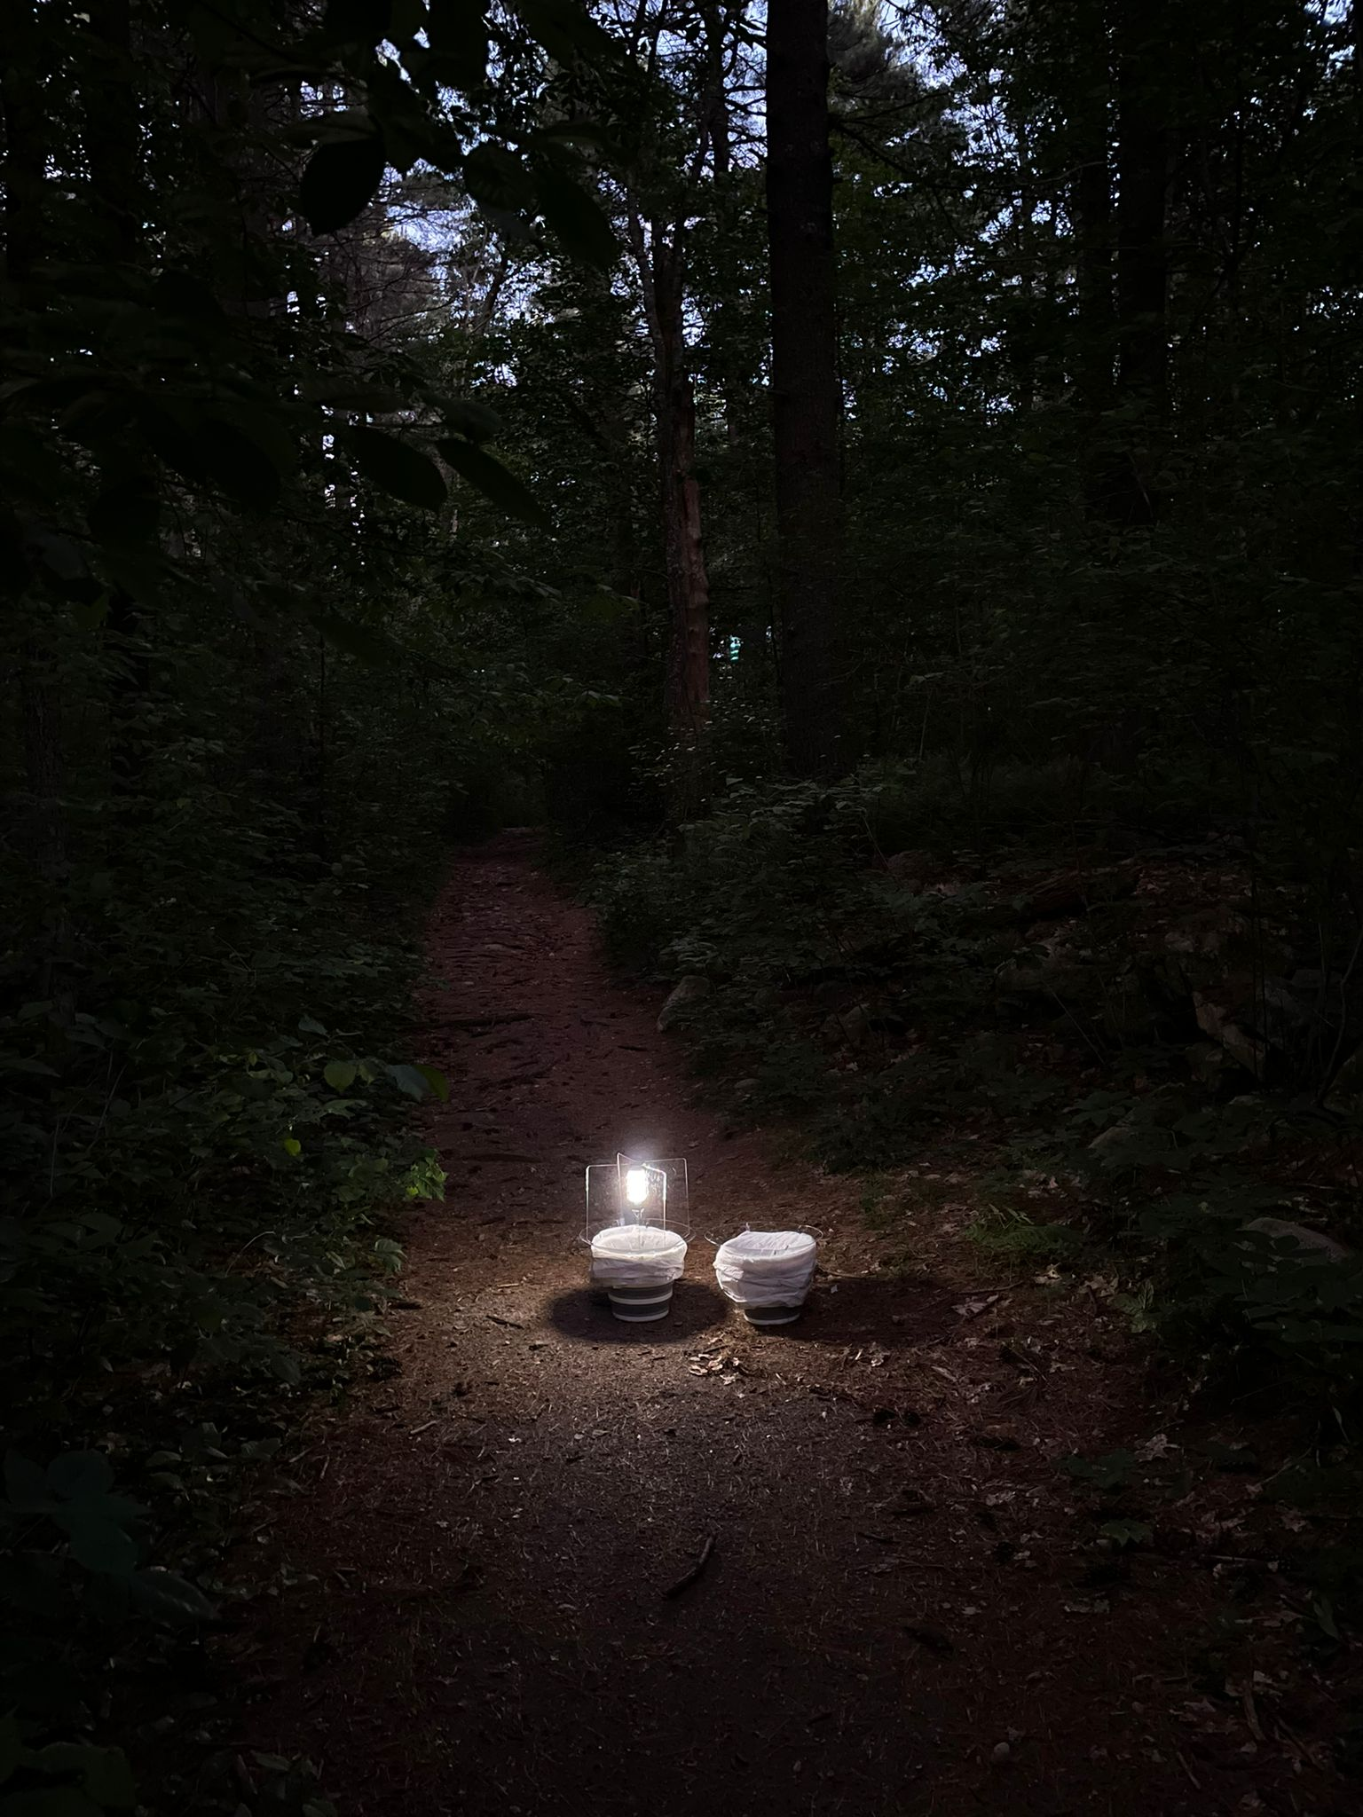
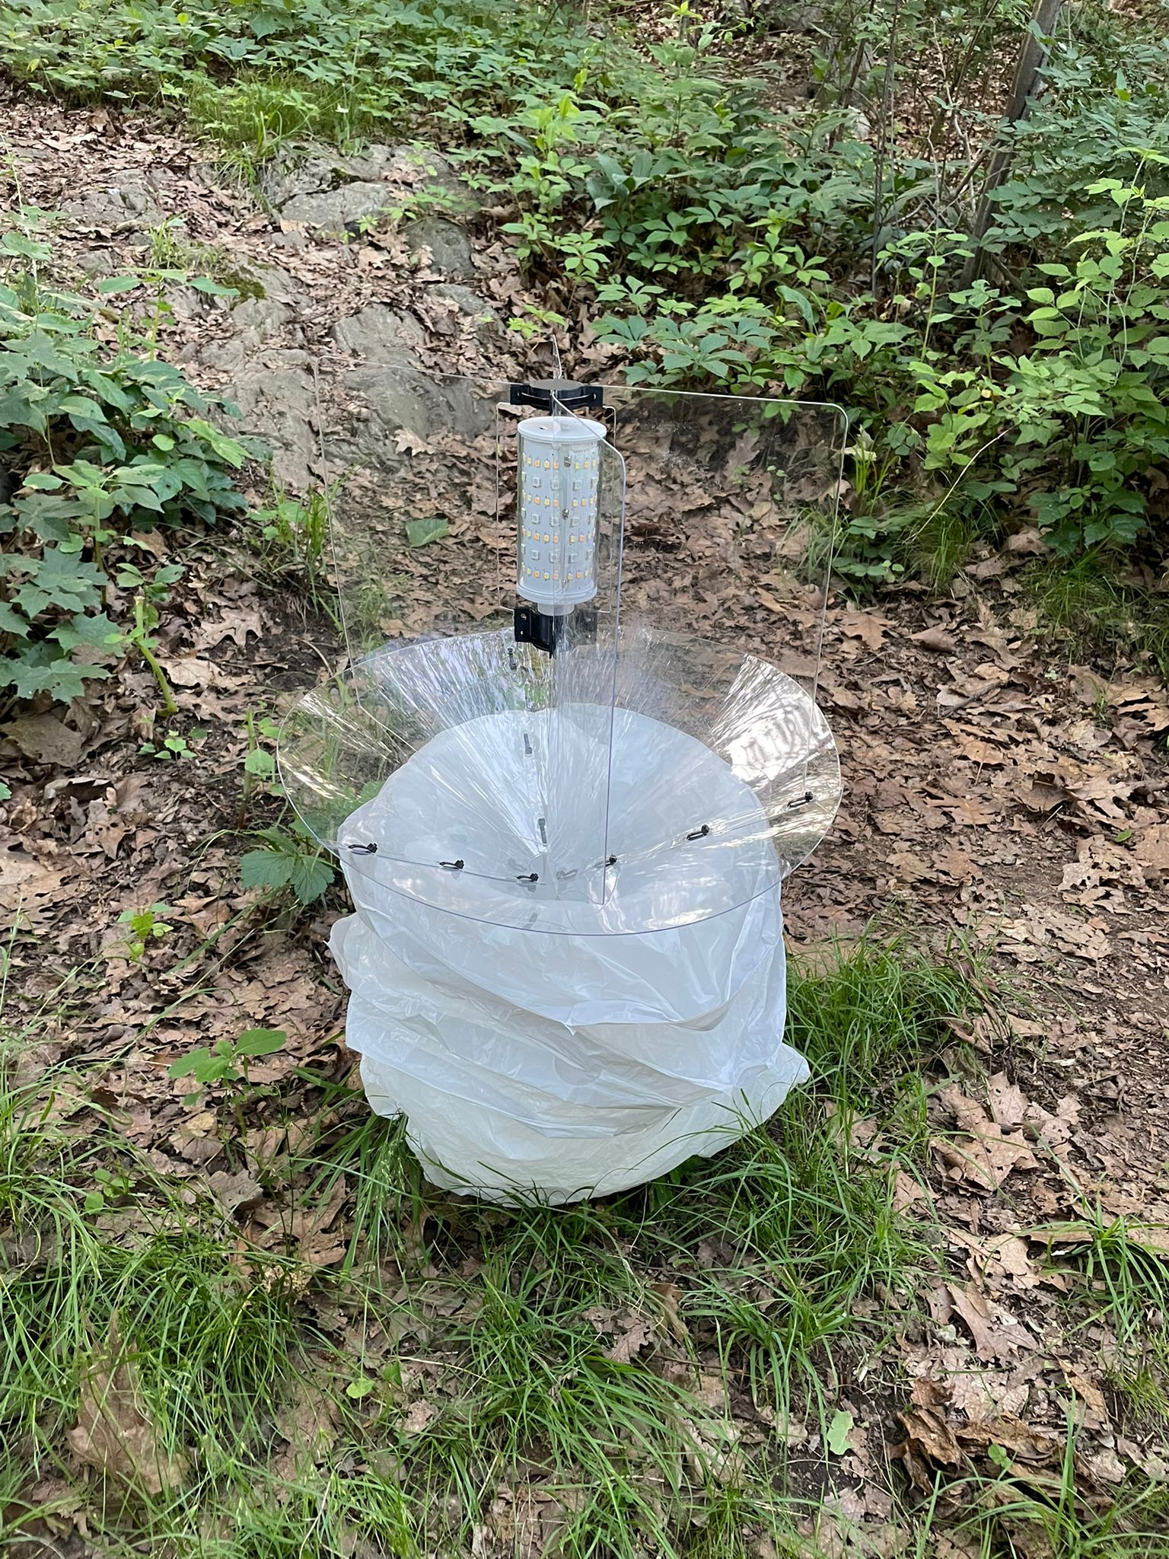
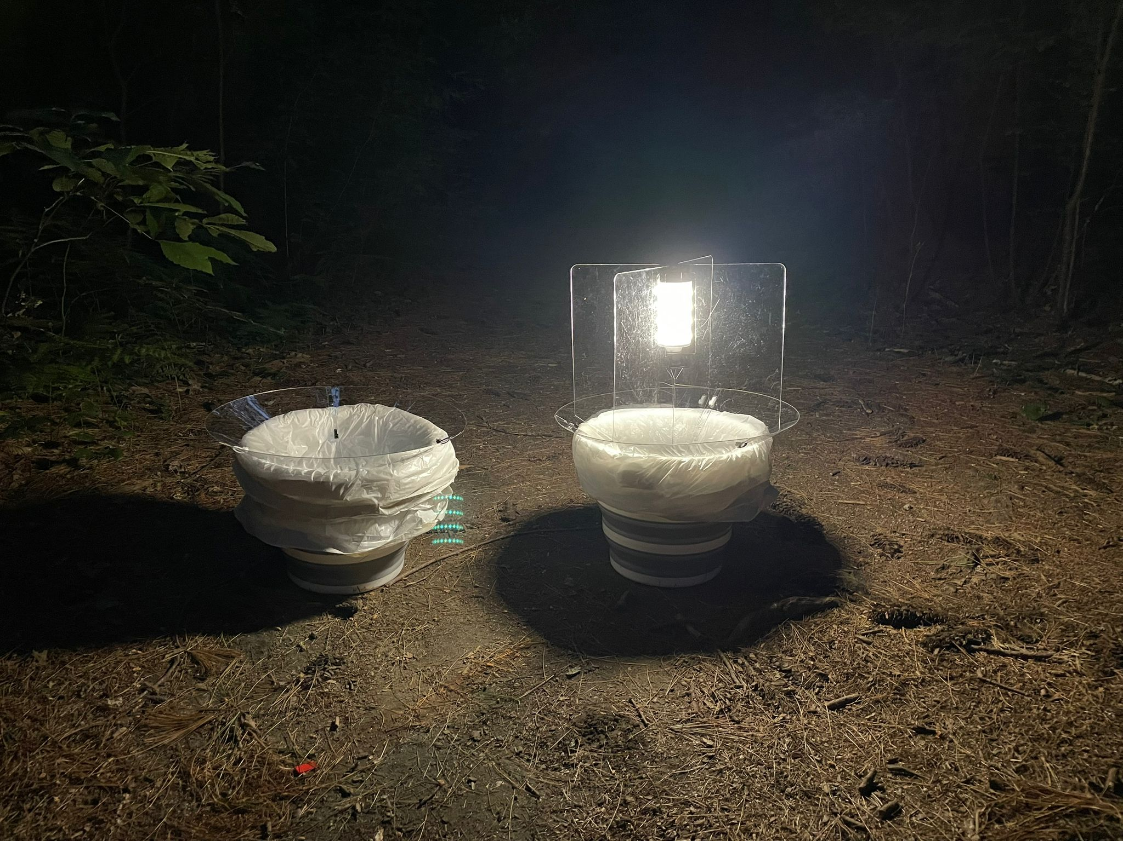
The bucket traps

Slide 6
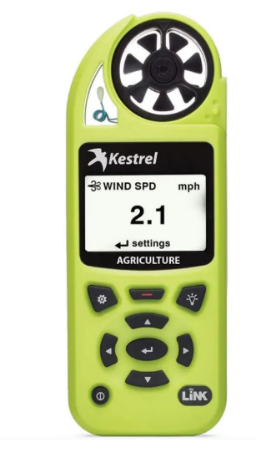
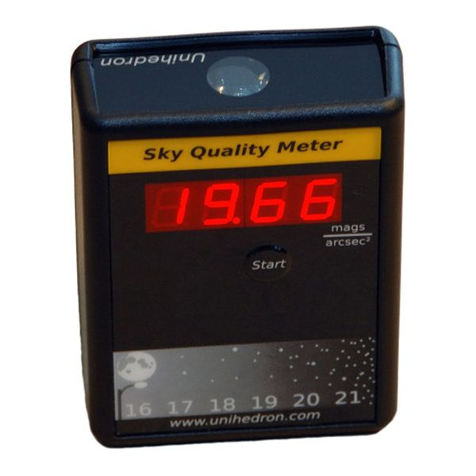
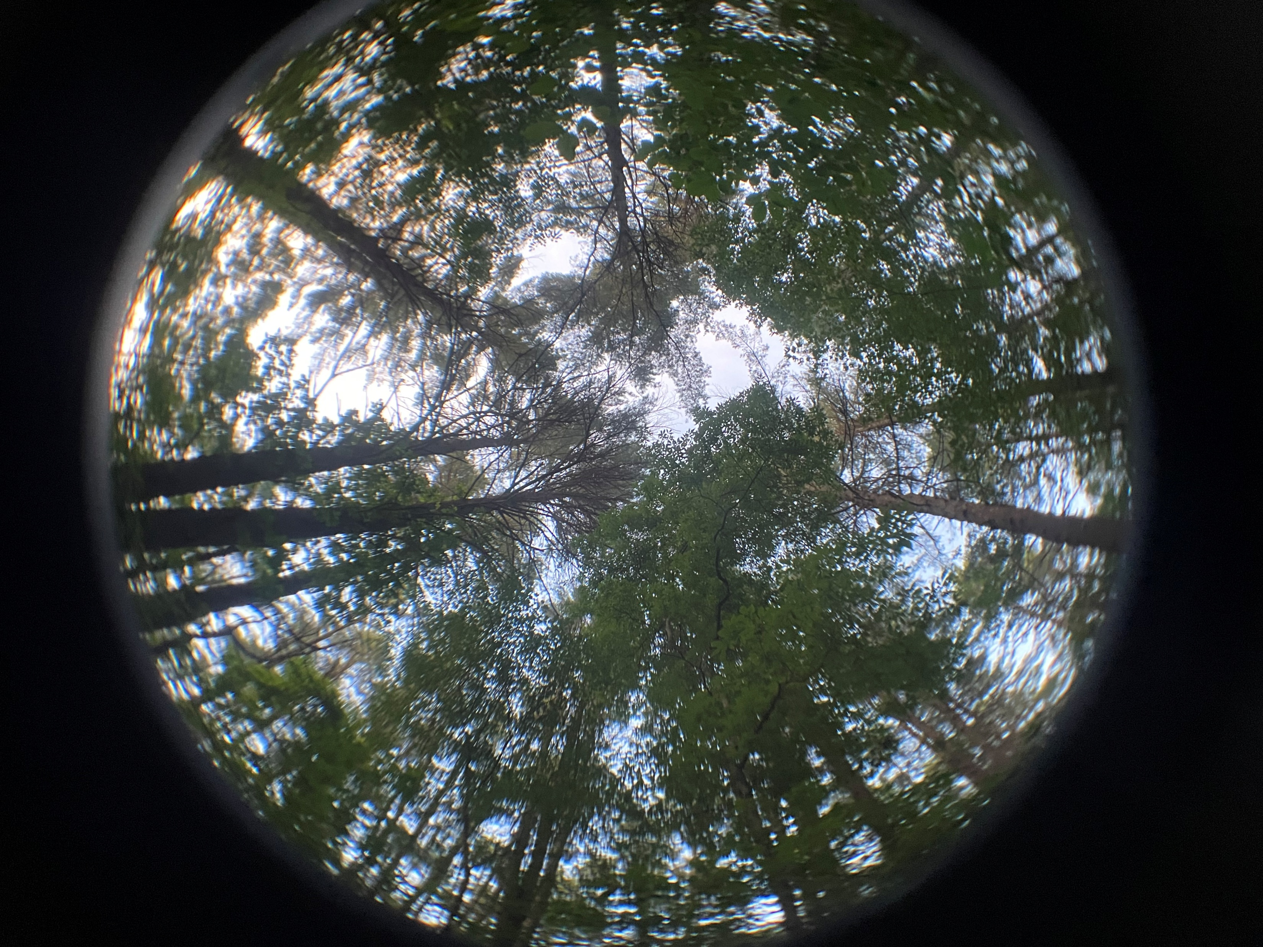
Environmental variables
SQM (mags/arcsec²)
17 weather parameters
Canopy cover

Slide 7
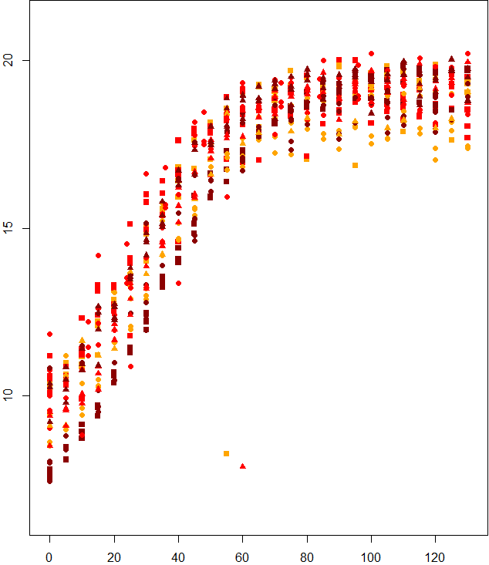
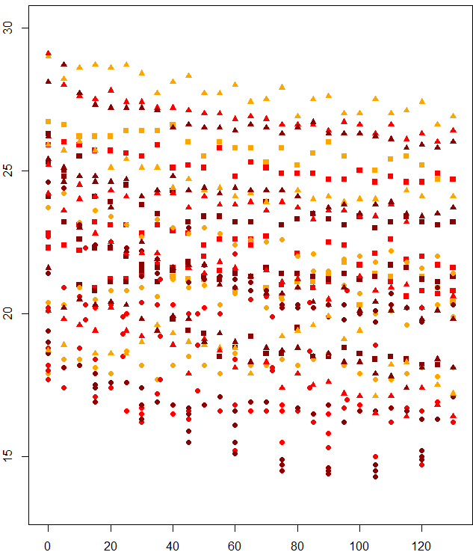
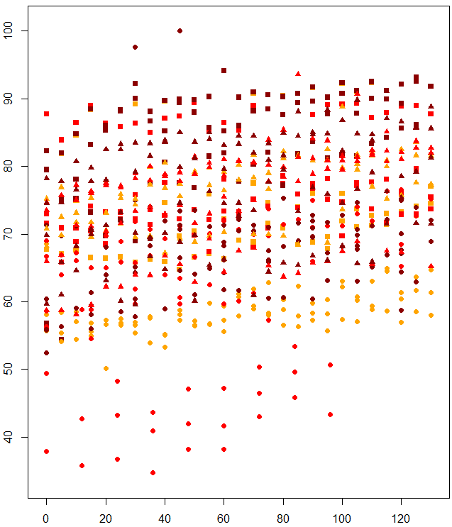
Environmental variables
SQM (mags/arcsec²)
Temperature
Humidity
Minutes after sunset

Slide 8
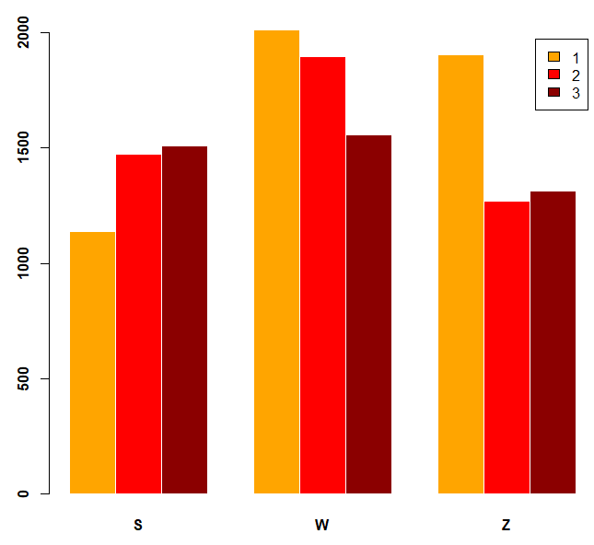
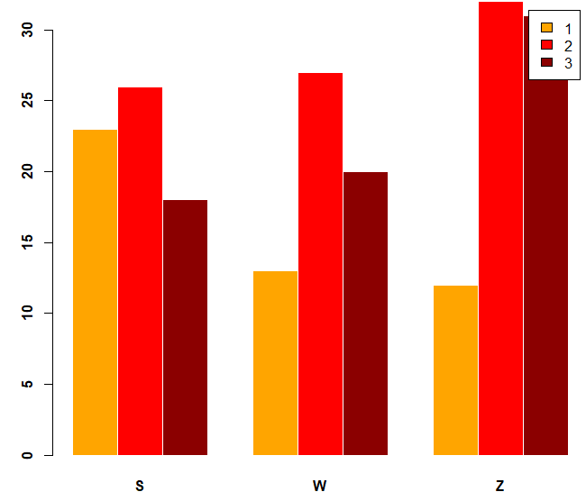
Insects count
13,360 insects from more than 16 orders
957 moths of 100 species, 77 genera, 14 families
Insect abundance
Moth diversity

Slide 9
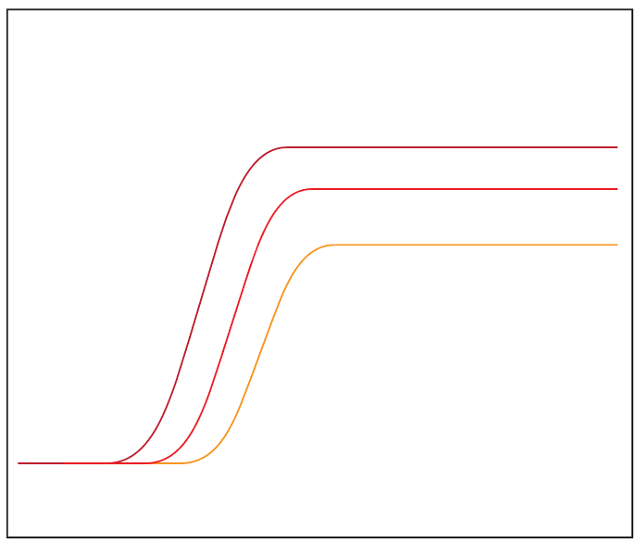
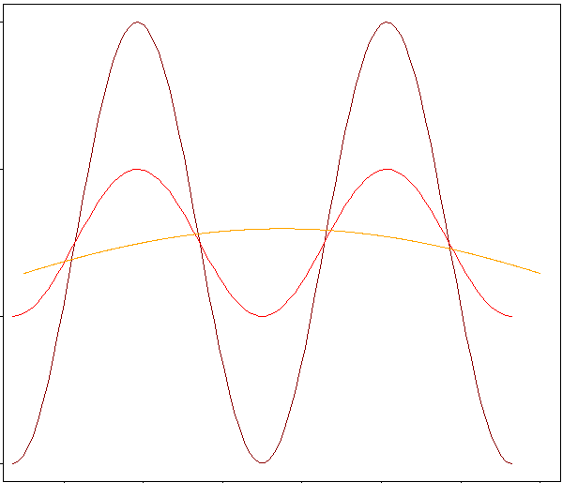
Hypotheses
Activity
Seasonality
Minutes after sunset
Day of year

Slide 10
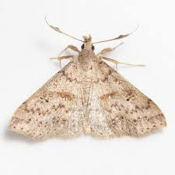
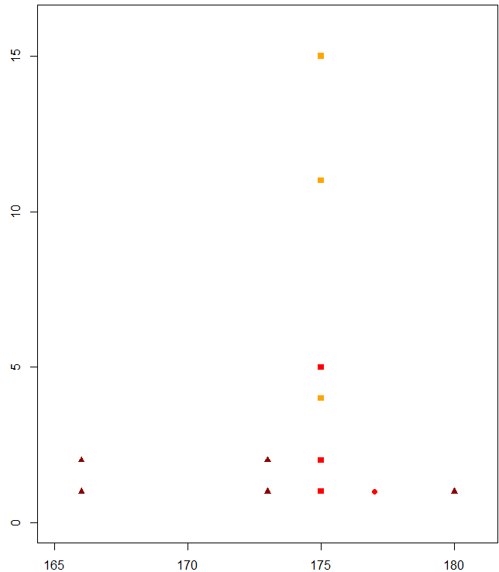
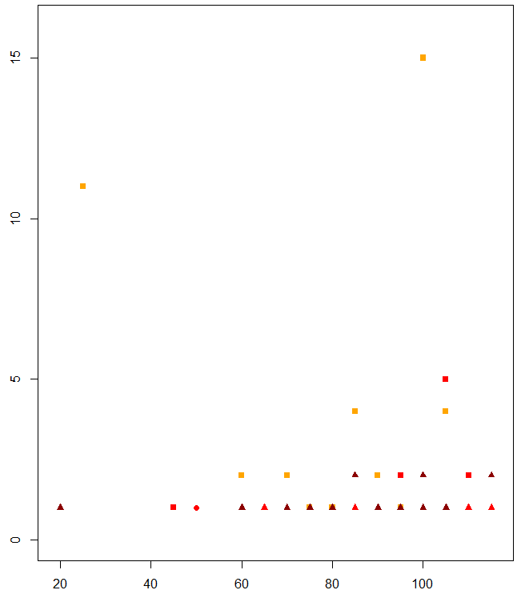
Example species – Renia salusalis
Day of year
Minutes after sunset

Slide 11
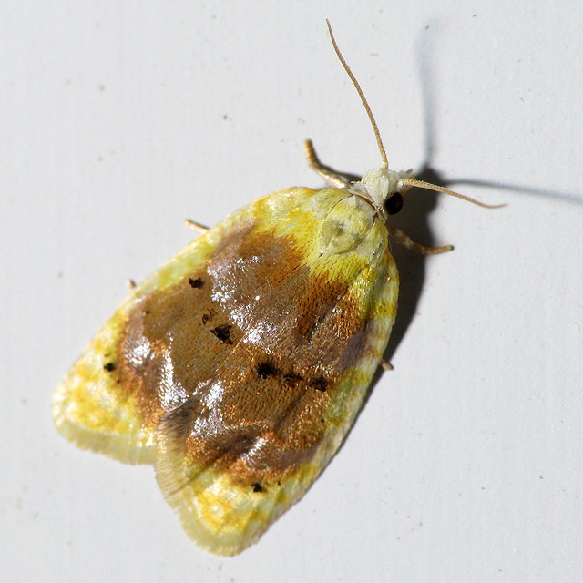
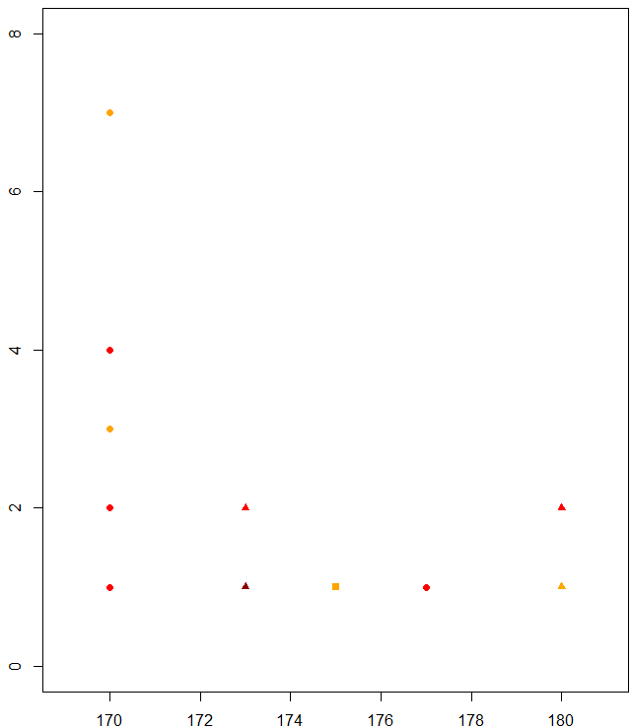
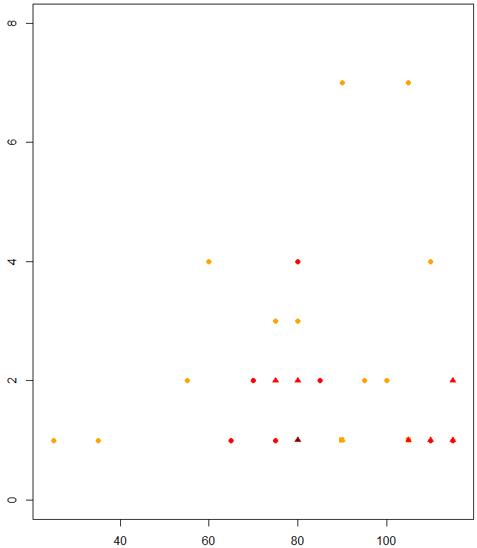
Example species – Acleris semipurpurana
Day of year
Minutes after sunset

